Slide 1
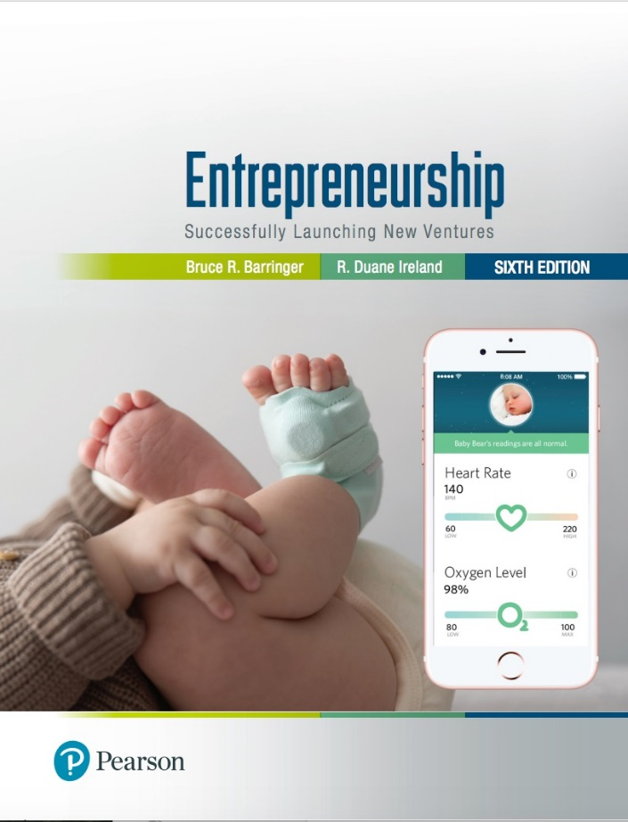
Entrepreneurship: Successfully Launching New Ventures
Sixth Edition
Chapter 11
Unique Marketing Issues
Notes:
If this PowerPoint presentation contains mathematical equations, you may need to check that your computer has the following installed:
1) MathType Plugin
2) Math Player (free versions available)
3) NVDA Reader (free versions available)

Slide 2
Learning Objectives (1 of 2)
11.1 Explain the three steps (segmenting the market, selecting a target market, and establishing a unique market position) entrepreneurial firms use to identify their customers.
11.2 Define a brand and explain why it is important to an entrepreneurial firm’s marketing efforts.
11.3 Identify and explain the 4Ps of marketing activities (product, price, promotion, and place) used by entrepreneurial firms.

Slide 3
Learning Objectives (2 of 2)
11.4 Describe the seven-step sales process an entrepreneurial firm uses to identify prospects and close sales.

Slide 4
Selecting a Market and Establishing a Position (1 of 2)
Important Questions That All Start-ups Must Ask
In order to succeed, a new firm must address this important issue: Who are our customers and how will we appeal to them?
A well-managed start-up approaches this query by following a three-step process:
Segmenting the market.
Selecting a target market.
Crafting a unique positioning strategy.

Slide 5
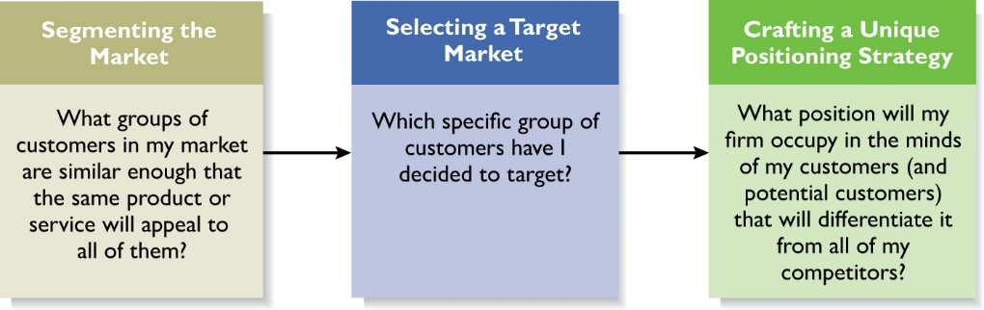
Selecting a Market and Establishing a Position (2 of 2)
Figure 11.1 The Process of Selecting a Target Market and Positioning Strategy

Slide 6
Market Segmentation
Segmenting the Market
Involves studying a firm’s industry and determining the different target markets in that industry.
Markets can be segmented in a number of different ways, including:
Geography (city, state, country).
Demographic variables (age, gender, family size).
Psychographic variables (personality, lifestyle, values).
Behavioral variables (benefits sought, brand loyalty).
Product type (varies by product).

Slide 7
Example: Segmenting the Computer Industry
The computer industry can be segmented in the following ways:
Product type (handheld computers, tablet computers, PCs, work stations, minicomputers, mainframes and super computers.
Customers served (individuals, businesses, schools or government).

Slide 8
Selecting a Target Market
Target Market
Once a firm has segmented the market, a target market must be chosen.
The market must be sufficiently attractive and the firm must have the capability to serve it.
By focusing on a clearly defined market, a firm can become an expert in that market and then be able to provide customers a high level of service.

Slide 9
Establishing a Unique Position (1 of 4)
Positioning
After selecting a target market, the firm’s next step is to establish a “position” within the market that differentiates it from its rivals.
A “position” is the part of a market that the firm is claiming as its own.
A firm establishes a unique position in its customers’ minds by drawing attention to two or three of the product’s attributes.

Slide 10
Establishing a Unique Position (2 of 4)
Positioning
After a company has its position and primary points of differentiation, a helpful technique is to develop a product attribute map.
A product attribute map illustrates a firm’s positioning strategy relative to its rivals.
The product attribute map for Casper (the mattress company featured in Case 5.2) is shown on the next slide.

Slide 11
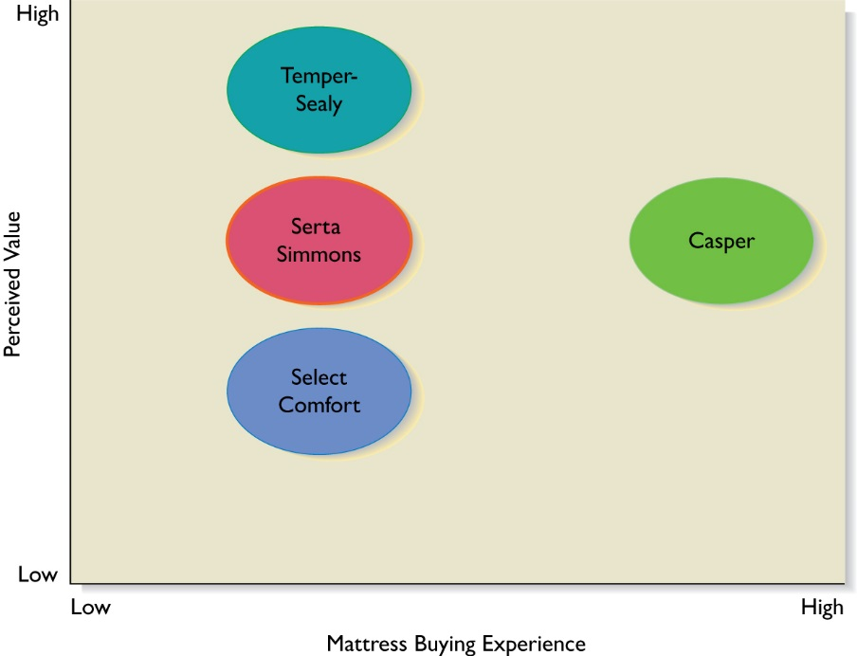
Establishing a Unique Position (3 of 4)
Figure 11.2 product attribute map for casper

Slide 12
Establishing a Unique Position (4 of 4)
Tagline
Firms often develop a “tagline” to reinforce the position they have staked out in their market, or a phrase that is used consistently in a company’s literature and thus becomes associated with the company.
An example is Nike’s familiar tagline, “Just do it.”
The beauty of this simple three-word expression is that it applies equally to a 21-year old triathlete and a 65-year-old mall walker.

Slide 13
Taglines—Developed to Reinforce a Firm’s Positioning Strategy
Table 11.1 Match the Company to Its Tagline
Company | Tagline
Wild Friends Foods | Live Better, Together!
Wiivv | Rest Assured.
Patients Like Me | Write Better. Write Smarter.
Billy Goat Ice Cream | Real Companies, Real Cases in Real Time.
Prynt | Making Food Friendly.
Rover.com | Explore. Pain-Free.
Write Lab | Health is in your hands.
Real Time Cases | The New Era of Photography.
Owlet Baby Care | Be Good. Eat Ice Cream.
Tyto Care | Love your dog. Love your life.

Slide 14
Branding (1 of 4)
Establishing a Brand
A brand is the set of attributes—positive or negative—that people associate with a company.
These attributes can be positive, such as trustworthy, innovative, dependable, or easy to deal with.
Or they can be negative, such as cheap, unreliable, arrogant, or difficult to deal with.
The customer loyalty a company creates through its brand is one of its most valuable assets.
Brand Management
Some companies monitor the integrity of their brands through a program called “brand management.”

Slide 15
Branding (2 of 4)
Table 11.2 What’s a Brand? Different Ways of Thinking About the Meaning of a Brand
A brand is a promise to serve stakeholders’ interests.
A brand is a firm’s guarantee of a level of performance.
A brand indicates the promises a firm makes to those it serves.
A brand expresses a firm’s reputation.
A brand presents a firm’s credentials.
A brand is an indicator of trust and reduced risk.
A brand describes a company’s nature.
A brand serves as a handshake between a firm and its customers.
Source: Adapted from Emotional Branding by Daryl Travis, copyright © 2000 by Daryl Travis. Used by permission of Pima Publishing, a division of Random House, Inc.

Slide 16
Branding (3 of 4)
Establishing a Brand
So how does a firm establish a brand?
On a philosophical level, a firm must have meaning in its customers’ lives. It must create value—something for which customers are willing to pay.
On a more practical level, brands are built through a number of techniques, including advertising, public relations, sponsorships, support of social causes, social media, and good performance.
A firm’s name, logo, website design, Facebook page, Instagram account and even its letterhead are part of its brand.

Slide 17
Branding (4 of 4)
Power of a Strong Brand
Ultimately, a strong brand can be a very powerful asset for a firm.
Over 50% of consumers say that a known and trusted brand is a reason to buy a product.
A brand allows a company to charge a price for its products that is consistent with its image.
A successful brand can increase the market value of a company by 50% to 75%.

Slide 18
The Four Ps of Marketing for New Ventures

Slide 19
Product (1 of 2)
Is the good or service a firm offers to its target market.
The most important attribute of a product is that it adds value in the mind of its target customers.
An important distinction should be made between a firm’s core product and the actual product.
The core product is the product itself, such as a CD that contains a tax preparation program.
The actual product is the product plus all the attributes that come with it such as features, design, packaging, and so on that constitutes the collection of benefits that the customer ultimately buys.

Slide 20
Product (2 of 2)
The initial rollout is one of the most critical times in the marketing of a new product.
All firms face the challenge that they are unknown and that it takes a leap of faith for the first customers to buy their products.
Some start-ups meet this challenge by using reference accounts.
A reference account is an early user of a firm’s product who is willing to give a testimonial regarding his or her experience with the product.

Slide 21
Price
Price is the amount of money consumers pay to buy a product.
The price a company charges for its products sends an important message to its target market.
For example, Oakley positions its sunglasses as innovative, state-of-the-art products that are both high quality and visually appealing.
This position in the market suggests a premium price that Oakley charges.
Most entrepreneurs use one of two methods to set the price for their products, as shown on the next slide.

Slide 22
Two Methods for Setting the Price of a Product
Cost-Based Pricing
The list price is determined by adding a markup percentage to a product’s cost.
Value-Based Pricing
The list price is determined by estimating what consumers are willing to pay for a product.

Slide 23
Promotion
Promotion
Refers to the activities the firm takes to communicate the merits of its product to its target market.
There are several common activities that entrepreneurs use to promote their products and services.
Advertising
Advertising is making people aware of a product or service in hopes of persuading them to buy it.

Slide 24
Pluses and Minuses of Advertising (1 of 2)
Pluses
Raise customer awareness of a product.
Explain a product’s comparative features and benefits.
Create associations between a product and a certain lifestyle.

Slide 25
Pluses and Minuses of Advertising (2 of 2)
Minuses
Low credibility.
The possibility that a high percentage of people who see the ad will not be interested.
Message clutter (meaning that after hearing or reading so many ads, people simply tune out).
Relative costliness compared to other forms of promotions.
The perception that advertising is intrusive.

Slide 26
Steps Involved In Putting Together an Advertisement
Figure 11.3

Slide 27
Google AdWords and AdSense Program (1 of 2)
AdWords
Allows advertisers to buy keywords on the Google home page.
Triggers text-based ads to the side of (and sometimes above) search results when the keyword is used.
The program includes local, national, and international distribution.
Advertisers pay a certain amount per click.
Advertisers benefit because they are able to place their ads in front of people who are already searching for information about their product.

Slide 28
Google AdWords and AdSense Program (2 of 2)
AdSense
Allows advertisers to buy ads that will be shown on other Web sites instead of Google’s home page.
Google selects sites of interest to the advertiser’s customers.
Advertisers are charged on a pay-per-click basis.
Advertisers benefit because the content of the ad is often relevant to the Web site.
Web site owners benefit by using the service to monetize their Web site.

Slide 29
Public Relations (1 of 2)
One of the most cost effective ways to increase the awareness of the products of a company is through public relations.
Public relations refer to efforts to establish and maintain a company’s image with the public.
The major difference between public relations and advertising is that public relations is not paid for—directly.

Slide 30
Public Relations (2 of 2)
Table 11.4 Public Relations Techniques
Press release.
Traditional media coverage.
Social media coverage.
Articles in industry press and periodicals.
Blogging.
Monthly newsletter.
Civic, social, and community involvement.

Slide 31
Social Media
Social Media
Consists primarily of blogging and connecting with customers and others through social networking sites such as Facebook, Twitter, Instagram, or Snapchat.
Blogging
The idea behind blogs is that they familiarize people with a business and help build an emotional bond between a business and its customers.
Facebook, Twitter, Instagram and Pinterest.
Businesses establish a presence on these sites to build a community around their products and services.

Slide 32
Other Promotions Techniques
Viral Marketing | Guerrilla Marketing
Facilitates and encourages people to pass along a marketing message about a particular product or service. | A low-budget approach to marketing that relies on ingenuity, cleverness, and surprise rather than traditional techniques.

Slide 33
Place (or Distribution)
Encompasses all the activities that move a firm’s product from its place of origin to the consumer.
The first choice a firm has to make regarding distribution is whether to sell its products directly to consumers or through intermediaries (such as wholesalers and retailers).
Within most industries, both choices are available, so the decision typically depends on how a firm believes its target market wants to buy its product.

Slide 34
Selling Direct Vs. Selling Through an Intermediary (1 of 2)
Approach to Distribution | Description
Selling Direct | Many firms sell direct to the customer, maintaining control of the distribution and sales process.
Selling Through Intermediaries | Other firms sell through intermediaries and pass off their products to wholesalers who place them in retail outlets to be sold.

Slide 35
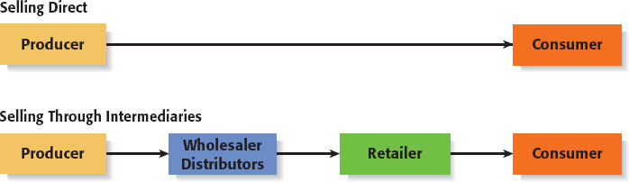
Selling Direct Vs. Selling Through an Intermediary (2 of 2)
Figure 11.4 Selling Direct versus Selling Through Intermediaries

Slide 36
Sales Process (1 of 3)
Sales Process
A firm’s sales process depicts the steps it goes through to identify prospects and close sales.
A formal sales process involves a number of identifiable steps.
Importance of Process
Some companies simply wing it when it comes to sales, which isn’t recommended.
It’s much better to have a well thought-out approach to prospecting customers and closing sales.

Slide 37
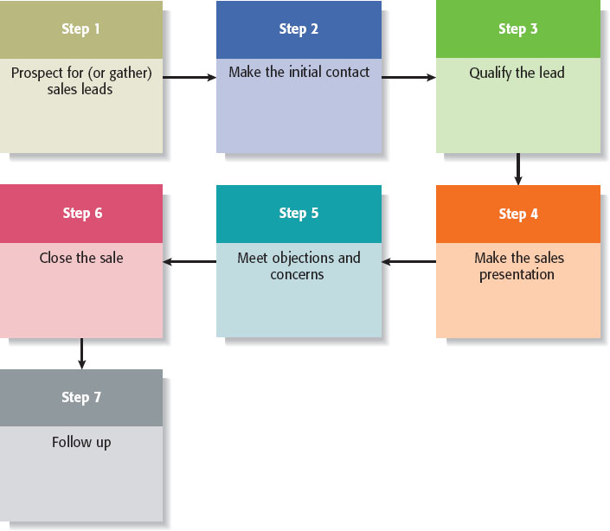
Sales Process (2 of 3)
Figure 11.5

Slide 38
Sales Process (3 of 3)
Usefulness of Sales Process
Mapping the sales process in the manner shown on the previous slide provides a standard method for a firm’s employees to use, and provides a starting point for careful analysis and continuous improvement.
Often, when companies lose an important sale they’ll find that an important step in the sales process was missed or mishandled.
Having a well thought-out sales process, along with appropriate follow-through, can dramatically improve a company’s sales performance.

Slide 39

Copyright

